Slide 1
Artificial Intelligence
Quantifying Uncertainty
Notes:
Slides and exercises are inspired by Russell & Norvig AI Book, Stanford’s AI course and from Berkeley’s AI course

Slide 2
Reminder
AI is the technique of uncertainty management in computer software (decision making software).
Sources of uncertainty:
Sensor limits
Adversaries
Stochastic environment
Laziness
Ignorance
How to quantify uncertainty?

Slide 3
Probabilistic reasoning
Observed variables (evidence): Agent knows certain things about the state of the world (e.g., sensor readings, or symptoms)
Unobserved variables: Agent needs to reason about other aspects (e.g. where an object is or what disease is present)
Model: Agent knows something about how the known variables relate to the unknown variables
Probability reasoning gives us a framework for managing our beliefs and knowledge

Slide 4
Bayes Networks
Bayes networks are probabilities that have a structure.
5 binary variables: 2⁵ parameters to represent all joint probabilities
With a Bayes network representation, we will see that all we need to represent the same space is 10 variables
Earthquake
Burglary
Alarm
Radio
Announcement
Neighbor
Call

Slide 5
Bayes Networks
Bayes networks are probabilities that have a structure.
What variables are observable?
What variables are hidden?
Earthquake
Burglary
Alarm
Radio
Announcement
Neighbor
Call
Notes:
Diagnostic reasoning vs. causal reasoning

Slide 6
This chapter
Probability and binary events
Random Variables
Joint and Marginal Distributions
Conditional Distribution
Independence, conditional independence
Chain Rule, Bayes’ Rule
Bayes nets, Parameters count
next chapter: D-separation, Bayesian Inference

Slide 7
Random variable
P(C=H) = 0.5
P(C=T) = ?
A random variable represents some aspect of the world about which we may have uncertainty
C (the outcome of a coin flip) is a random variable
{H,T} is the domain of C
Notes:
0.5

Slide 8
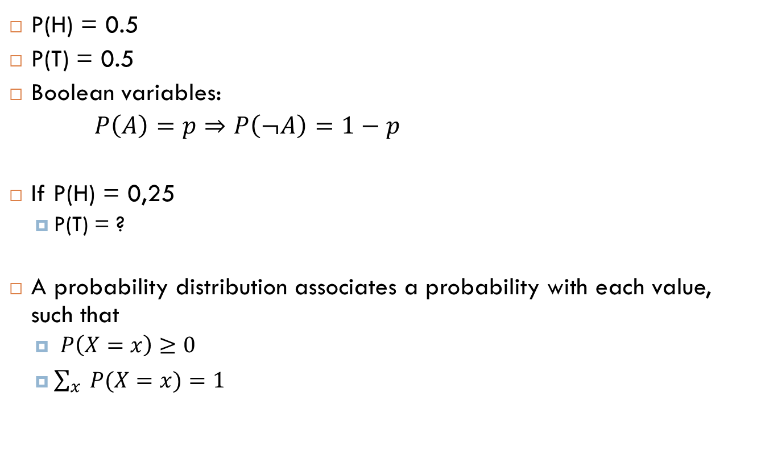
Probability distribution
P(H) = 0.5
P(T) = 0.5
Boolean variables:
$P\left(A\right)=p⇒P\left(¬A\right)=1−p$
If P(H) = 0,25
P(T) = ?
A probability distribution associates a probability with each value, such that
$P\left(X=x\right)≥0$
$\sum_{x}{P(X=x)}=1$
Notes:
0.75

Slide 9

Joint distribution
P(H) = 1/2
P(X₁=H, X₂=H, X₃=H) =
P(H, H, H) = ?
A joint distribution over a set of random variables X₁, X₂, … X_{n} specifies a real number for each assignment, such that
$P\left(x_{1},x_{2}, …,x_{n}\right)≥0$
$$\sum_{{(x}_{1},x_{2}, …,x_{n})}{P(x_{1},x_{2}, …,x_{n})}=1$$
Notes:
½*1/2*1/2 = 1/8 = 0.125

Slide 10
Size of distribution
The size of distribution of n variables with domain sizes d is: d^{n}
Impractical for all but the smallest distributions

Slide 11

Example
X_{i} is the random variable representing the i^{th} coin flip. $X_{i}∈\left\{H,T\right\}$
${ P}_{i}\left(H\right)=1/2$
P(X₁=X₂=X₃=X₄) = ?
Notes:
0.5

Slide 12

Example – solution
X_{i} is the result of the i^{th} coin flip. $X_{i}∈\{H,T\}$
P(X₁=X₂=X₃=X₄) = 1/16+1/16 = 1/8

Slide 13

Example
X_{i} is the result of the i^{th} coin flip. $X_{i}∈\{H,T\}$
P(X₁,X₂,X₃,X₄ have at least 3 heads) = ?

Slide 14
Example – solution
½ * ½ * ½ * ½ +
½ * ½ * ½ * ½ +
½ * ½ * ½ * ½ +
½ * ½ * ½ * ½ +
½ * ½ * ½ * ½ =
5/16 = 0.3125

Slide 15
Probabilistic model
A probabilistic model is a joint distribution over a set of random variables
An event is a set of outcomes (assignments)
Weather
Distribution over T,W
T | W | P
Hot | Sun | 0.4
Hot | Rain | 0.1
Cold | Sun | 0.2
Cold | Rain | 0.3
Temperature
P(cold, sun) = ?
P(hot) =?
P(rain)=?
Notes:
P(hot) = 0.4+0.1 = 0.5
P(rain) = 0.1+0.3 = 0.4

Slide 16

Marginal distributions
Marginal distributions are sub-tables which eliminate variables
$$P\left(X_{1}=x_{1} \right)=\sum_{x_{2}}{P(X_{1}=x_{1},X_{2}=x_{2})}$$
P(X,Y)
P(X)
X | P
+x
-x
X | Y | P
+x | +y | 0.2
+x | -y | 0.3
-x | +y | 0.4
-x | -y | 0.1
P(Y)
Y | P
+y
-y

Slide 17

Conditional probability
Conditional probability is a simple relation between joint and marginal probabilities:
$$P(A|B) = \frac{P(A,B) }{P(B)}$$
P(a,b)
P(a)
P(b)

Slide 18
Example
P(+x| -y)=?
P(-x| +y) =?
P(-y| +x) = ?
P(X,Y)
X | Y | P
+x | +y | 0.2
+x | -y | 0.3
-x | +y | 0.4
-x | -y | 0.1

Slide 19
Conditional distribution
Conditional distributions are probability distributions over some variables given fixed values of others
Conditional distributions P(W|T=hot)
W | P
Sun | 0.8
Rain | 0.2
P(W|T=cold)
W | P
Sun | 0.4
Rain | 0.6
Joint Distribution P(T,W)
T | W | P
Hot | Sun | 0.4
Hot | Rain | 0.1
Cold | Sun | 0.2
Cold | Rain | 0.3
P(W|T)

Slide 20
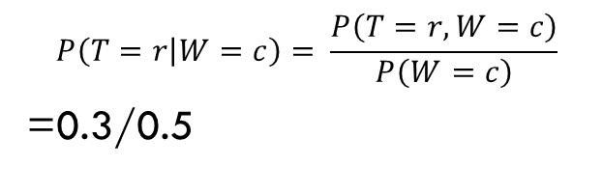
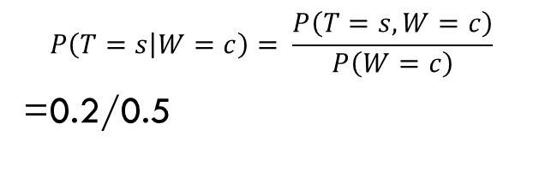

Normalization trick
$$P\left(T=s | W=c\right)= \frac{P\left(T=s,W=c\right)}{P\left(W=c\right)}$$
=0.2/0.5
$$P\left(T=r | W=c\right)= \frac{P\left(T=r,W=c\right)}{P\left(W=c\right)}$$
=0.3/0.5
Do we need to compute $P(W=c)$ ?
Select the joint probabilities matching the evidence
P(T,W)
T | W | P
Hot | Sun | 0.4
Hot | Rain | 0.1
Cold | Sun | 0.2
Cold | Rain | 0.3
Normalize the selection (make it sum to one)
P(c,W)
T | W | P
Cold | Sun | 0.2
Cold | Rain | 0.3
P(W|T=c)
W | P
Sun | 0.4
Rain | 0.6
Notes:
No

Slide 21
Example
P(X|Y=-y) ? (Use normalization)
P(X,Y)
X | Y | P
+x | +y | 0.2
+x | -y | 0.3
-x | +y | 0.4
-x | -y | 0.1
Notes:
P(+x|-y) = 0.3/0.4
P(-x|-y) = 0.1/0.4

Slide 22

Chain rule
We can write any joint distribution as an incremental product of conditional distributions
$P\left(x_{1},x_{2},x_{3}\right)={P(x}_{1}).P\left(x_{2} | x_{1}\right).P(x_{3}|x_{1},x_{2})$
$P\left(x_{1},x_{2},{…,x}_{n}\right)=\prod_{i}{P(}x_{i}|x_{i−1}, …,x_{1})$

Slide 23

Independence
$X ⊥Y :P\left(X\right)P\left(Y\right)=P\left(X,Y\right)$
Independence is a simplifying modeling assumption
“All models are wrong; but some are useful “
George E. Box
Marginal probability
Joint probability

Slide 24
Example
P(W)
W | P
Sun | 0.6
Rain | 0.4
P(T)
T | P
Hot | 0.5
Cold | 0.5
P₁(T,W)
T | W | P
Hot | Sun | 0.4
Hot | Rain | 0.1
Cold | Sun | 0.2
Cold | Rain | 0.3
P₂(T,W)
T | W | P
Hot | Sun | 0.3
Hot | Rain | 0.2
Cold | Sun | 0.3
Cold | Rain | 0.2
Assuming P₁(T,W), are T and W independent ?
What about P₂ ?
Notes:
Given P1, No
Given P2, Yes

Slide 25
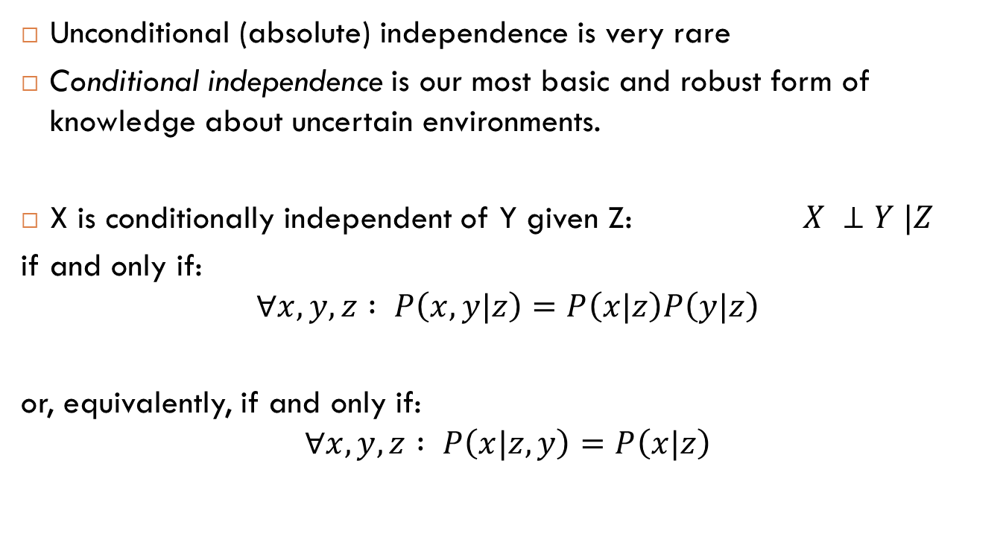
Conditional independence
Unconditional (absolute) independence is very rare
Conditional independence is our most basic and robust form of knowledge about uncertain environments.
X is conditionally independent of Y given Z: $X ⊥Y |Z$
if and only if:
$$∀x,y,z : P\left(x,y|z\right)=P\left(x|z\right)P\left(y|z\right)$$
or, equivalently, if and only if:
$$∀x,y,z : P\left(x|z,y\right)=P\left(x|z\right)$$

Slide 26
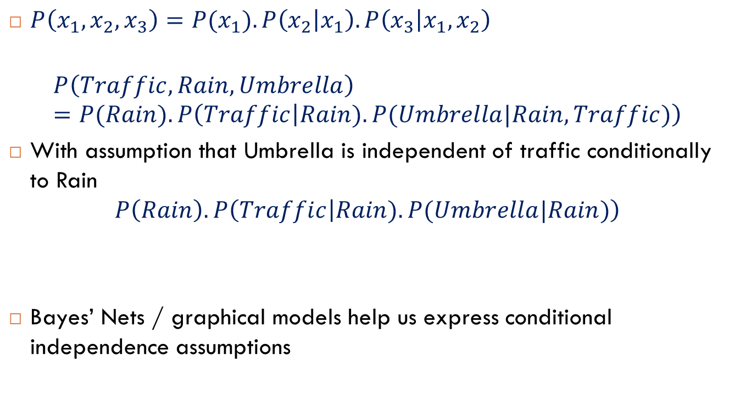
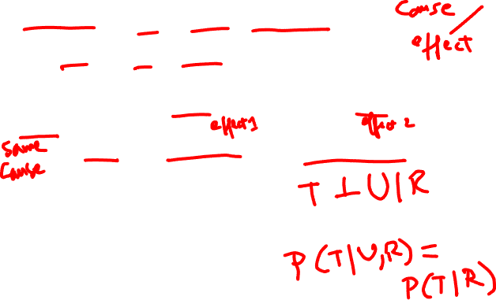
Conditional independence + chain rule
$P\left(x_{1},x_{2},x_{3}\right)={P(x}_{1}).P\left(x_{2} | x_{1}\right).P\left(x_{3} | x_{1},x_{2}\right)$
$$P\left(Traffic,Rain,Umbrella\right)=P(Rain).P\left(Traffic | Rain).P(Umbrella|Rain,Traffic)\right)$$
With assumption that Umbrella is independent of traffic conditionally to Rain
$$P\left(Rain\right).P\left(Traffic | Rain).P(Umbrella|Rain)\right)$$
Bayes’ Nets / graphical models help us express conditional independence assumptions

Slide 27
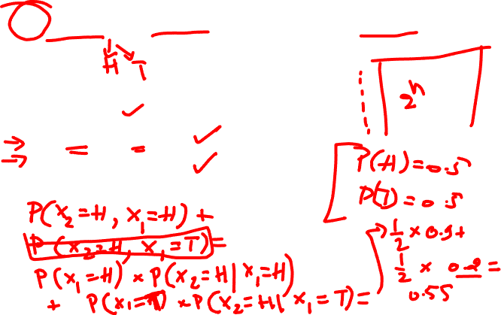
What if coin flips are dependent?
If n coin flips are dependent, the size of their joint distribution is 2^{n}
P(X₁=H) = ½
P(X₂ = H | X₁= H) = 0.9
P(X₂ = T | X₁ = T) = 0.8
P(X₂=H) = ?
Conditional probabilities

Slide 28

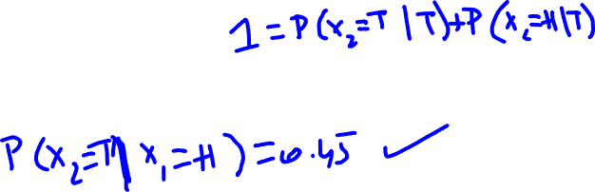
What if coin flips are dependent?
P(X₁=H) = ½
P(X₂ = H / X₁= H) = 0.9
P(X₂ = T / X₁ = T) = 0.8
$P\left(X2=H\right)=$
$$P(X2=H/X1=H) P (X1=H) + P(X2=H / X1=T) P(X1=T) = ½ ∗ 0.9 + ½ ∗ 0.2 = 0.55$$
Theorem of total probability

Slide 29

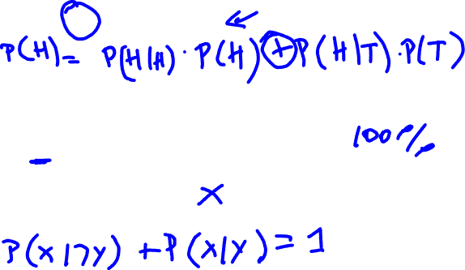
Total probability
$P\left(Y\right)= \sum_{i}{P\left(Y | { X}_{i}\right) P({ X}_{i})}$
$P\left(¬X | Y\right)=1−P\left(X | Y\right)$
$P\left(X | ¬Y\right)=1−P\left(X | Y\right)$
True
False

Slide 30
Total probability
$P\left(Y\right)= \sum_{i}{P\left(Y | { X}_{i}\right) P({ X}_{i})}$
$P\left(¬X | Y\right)=1−P\left(X | Y\right)$
$P\left(X | ¬Y\right)=1−P\left(X | Y\right)$
False

Slide 31
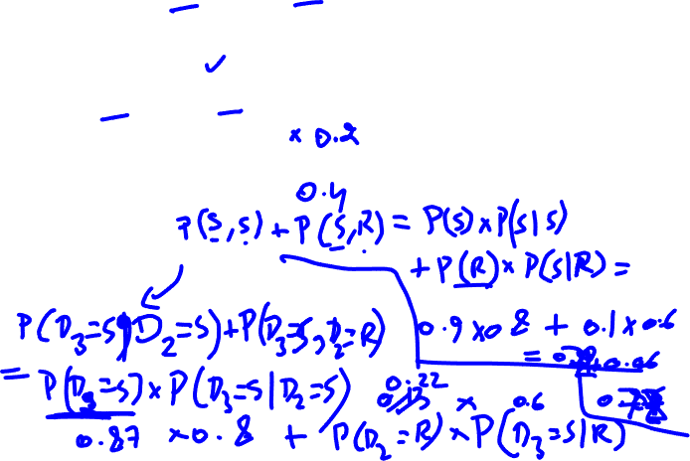
Example: Sunny / Rainy
P(D₁=Sunny)=0.9
P(D₂=Sunny/D₁=Sunny) = 0.8
P(D₂=Rainy/D₁=Sunny) = ?
P(D₂=Sunny/D₁=Rainy) = 0.6
P(D₂=Rainy/D₁=Rainy) = ?
P(D₂=Sunny)=?
P(D₃=Sunny)=?
2 variables,
3 parameters

Slide 32
Example: Sunny / Rainy
P(D₁=Sunny)=0.9
P(D₂=Sunny/D₁=Sunny) = 0.8
P(D₂=Rainy/D₁=Sunny) = 0.2
P(D₂=Sunny/D₁=Rainy) = 0.6
P(D₂=Rainy/D₁=Rainy) = 0.4
P(D₂=Sunny)=
P(D₂=Sunny|D₁=Rainy)P(D₁=Rainy)+P(D₂=Sunny|D₁=Sunny)P(D₁=Sunny) = 0.6*0.1+0.8*0.9=0.78
P(D₃=Sunny)=
P(D₃=Sunny|D₂=Rainy)P(D₂=Rainy)+P(D₃=Sunny|D₂=Sunny)P(D₂=Sunny)=0.6*0.22+0.8*0.78=0.756

Slide 33
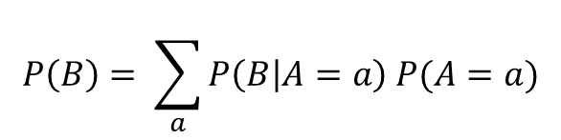

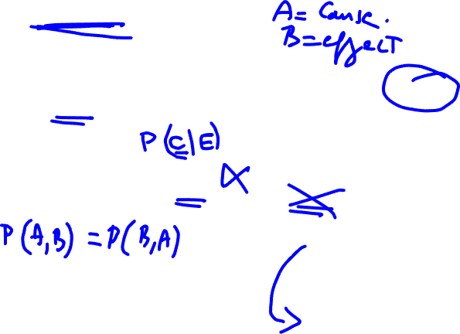
Bayes Rule
$$P(A|B) = \frac{P(B|A) P(A)}{P(B)}$$
Prior
Posterior
Likelihood
Marginal likelihood
computed by the total probability rule:
$$P\left(B\right)= \sum_{a}{P\left(B | A=a\right) P(A=a)}$$

Slide 34
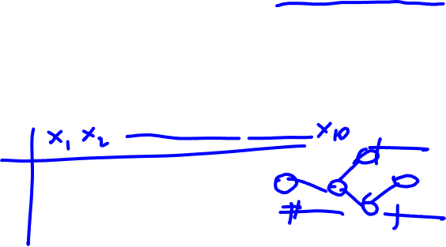
Definition
Bayesʼ nets: a technique for describing complex joint distributions (models) using simple, local distributions (conditional probabilities)
More properly called graphical models
We describe how variables locally interact
Local interactions chain together to give global, indirect interactions

Slide 35
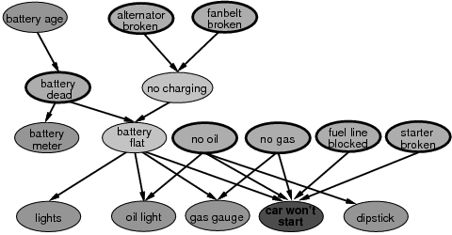

Example of Bayes net models
Insurance
Car

Slide 36
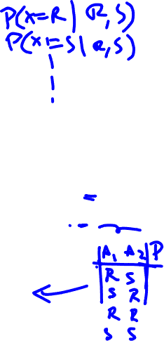
Graphical models
Nodes: variables (with domains):
Can be assigned (observed) or unassigned (unobserved)
Arcs: interactions
Indicate “direct influence” between variables
For now, mean direct causation
We will see that more generally what they really encode is conditional independence
Bayes Net:
A directed, acyclic graph model
A conditional distribution for each node, given its parents
This distribution is called CPT: Conditional Probability Table
A Bayes net=Topology(graph)+Local Conditional Probabilities

Slide 37
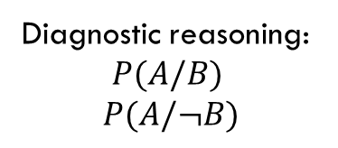
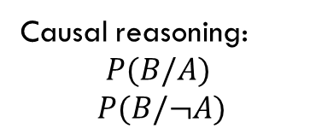
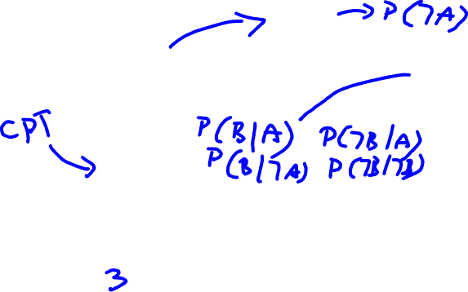
Simplest Bayes network
Prior: P(A)
A
Not-Observable
Causal reasoning:
$$P(B/A)$$
$$P(B/¬A)$$
B
Observable
Diagnostic reasoning:
$$P(A/B)$$
$$P(A/¬B)$$
How many numerical parameters define this Bayes network?

Slide 38
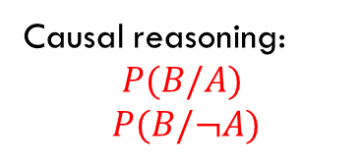

Simplest Bayes networks
Prior: P(A)
A
Not-Observable
Causal reasoning:
$$P(B/A)$$
$$P(B/¬A)$$
B
Observable
Diagnostic reasoning:
$$P(A/B)$$
$$P(A/¬B)$$
How many numerical parameters define this Bayes network?
3

Slide 39

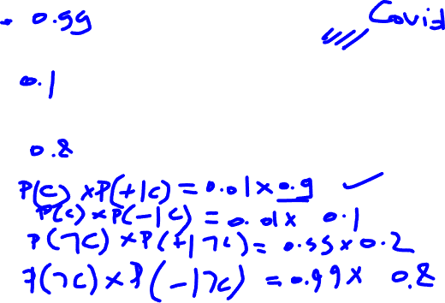
Example: Cancer Test
$P(C) = 0.01$
$P\left(¬C\right)= ?$
$P(+|C)=0.9$
$P(−|C) = ?$
$P\left(+|¬C\right)=0.2$
$P\left(−|¬C\right)=?$
$P(+,C) =?$
$P(−,C) = ?$
$P(+,$ $¬C)=?$
$P(−,$ $¬C)=?$
Cancer
Test

Slide 40

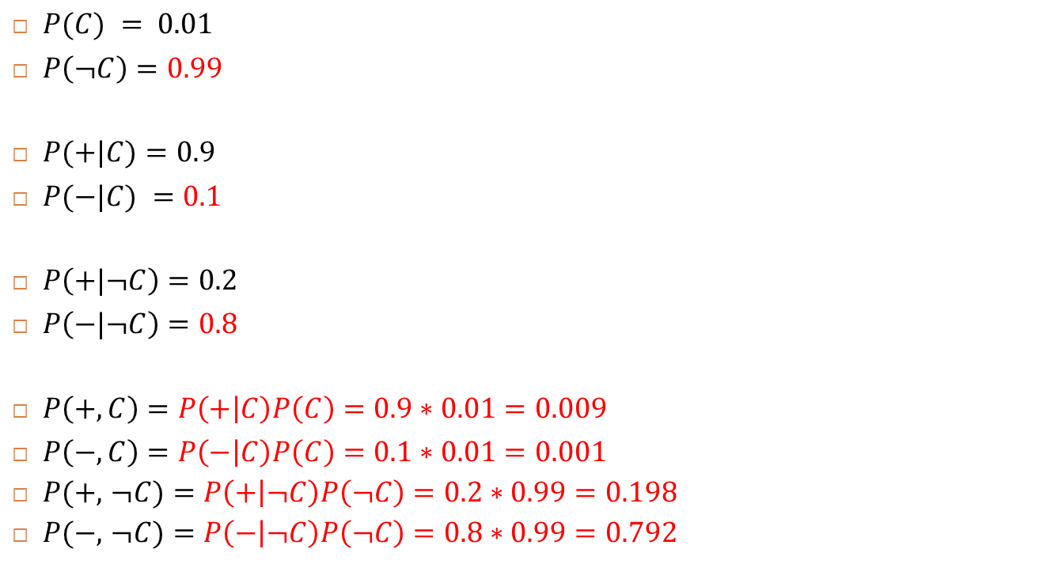
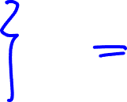
Example: Cancer Test
$P(C) = 0.01$
$P\left(¬C\right)=0.99$
$P(+|C)=0.9$
$P(−|C) =0.1$
$P\left(+|¬C\right)=0.2$
$P\left(−|¬C\right)=0.8$
$P\left(+,C\right)=P\left(+ | C\right)P\left(C\right)=0.9∗0.01=0.009$
$P\left(−,C\right)=P\left(− | C\right)P\left(C\right)=0.1∗0.01=0.001$
$P(+,$ $¬C)=P\left(+ | ¬C\right)P\left(¬C\right)=0.2∗0.99=0.198$
$P(−,$ $¬C)=P\left(− | ¬C\right)P\left(¬C\right)=0.8∗0.99=0.792$
$$sum=1$$

Slide 41

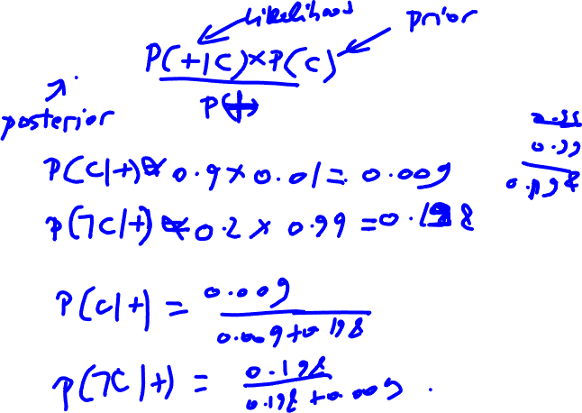
Example: Cancer test / Diagnostic
$P\left(C | +\right)=?$
Cancer
Test

Slide 42


Example: Cancer test / Diagnostic
$P(C,+) = P(C|+)P(+)$
$P\left(C | +\right)=\frac{P\left(C,+\right)}{P\left(+\right)}=\frac{P\left(C,+\right)}{P\left(C,+\right)+P(¬C,+)}=\frac{0.009}{0.009+0.198}=0.0434$
Cancer
Test

Slide 43
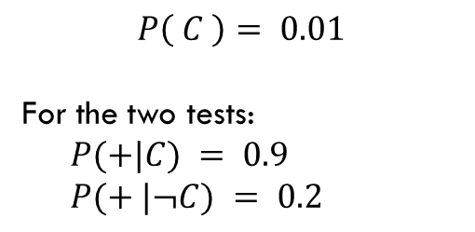
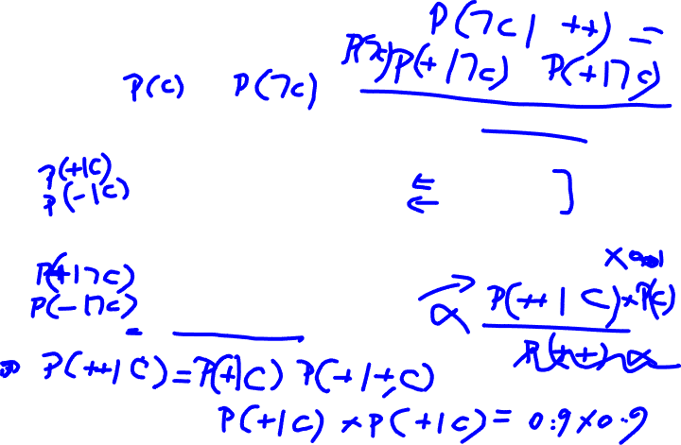
2 Tests Cancer Example
Cancer
$$P\left( C \right)= 0.01$$
For the two tests:
$P(+|C) = 0.9$
$P(+ |¬C) = 0.2$
Test 1
Test 2
$$P\left(C | test1 = + ; test2 = +\right)= P\left(C | ++\right)=?$$

Slide 44
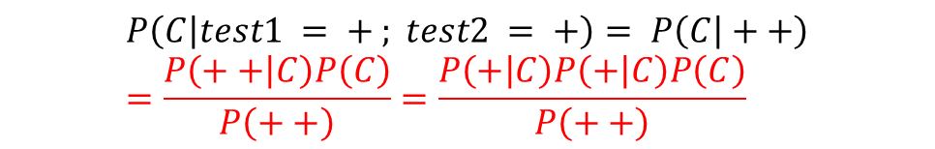
2 Tests Cancer Example
Cancer
$$P\left( C \right)= 0.01$$
For the two tests:
$P(+|C) = 0.9$
$P(+ |¬C) = 0.2$
Test 1
Test 2
$$P\left(C | test1 = + ; test2 = +\right)= P\left(C | ++\right)=\frac{P\left(++ | C\right)P\left(C\right)}{P\left(++\right)}=\frac{P\left(+ | C\right)P\left(+ | C\right)P\left(C\right)}{P\left(++\right)}$$

Slide 45
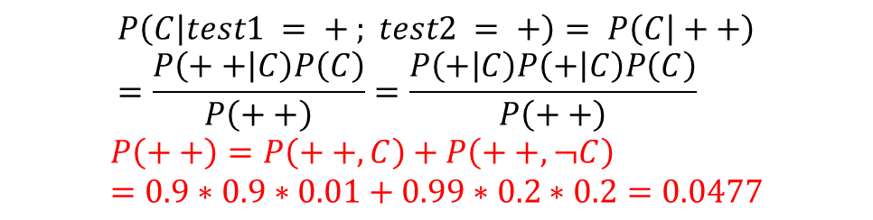
2 Tests Cancer Example
Cancer
$$P\left( C \right)= 0.01$$
For the two tests:
$P(+|C) = 0.9$
$P(+ |¬C) = 0.2$
Test 1
Test 2
$$P\left(C | test1 = + ; test2 = +\right)= P\left(C | ++\right)=\frac{P\left(++ | C\right)P\left(C\right)}{P\left(++\right)}=\frac{P\left(+ | C\right)P\left(+ | C\right)P\left(C\right)}{P\left(++\right)}$$
$$P\left(++\right)=P\left(++,C\right)+P\left(++,¬C\right)=0.9∗0.9∗0.01+0.99∗0.2∗0.2=0.0477$$

Slide 46
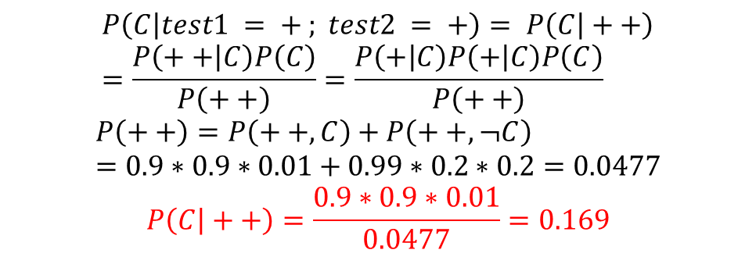

2 Tests Cancer Example
Cancer
$$P\left( C \right)= 0.01$$
For the two tests:
$P(+|C) = 0.9$
$P(+ |¬C) = 0.2$
Test 1
Test 2
$$P\left(C | test1 = + ; test2 = +\right)= P\left(C | ++\right)=\frac{P\left(++ | C\right)P\left(C\right)}{P\left(++\right)}=\frac{P\left(+ | C\right)P\left(+ | C\right)P\left(C\right)}{P\left(++\right)}$$
$$P\left(++\right)=P\left(++,C\right)+P\left(++,¬C\right)=0.9∗0.9∗0.01+0.99∗0.2∗0.2=0.0477$$
$$P\left(C | ++\right)=\frac{0.9∗0.9∗0.01}{0.0477}=0.169$$

Slide 47


Conditional independence
$T1⊥T2 | C$
T1 is conditionally independent of T2 given C
$P\left(T1 | T2,C\right)=P\left(T1 | C\right)$
$P\left(T2 | T1,C\right)=P\left(T2 | C\right)$
Cancer
Test 1
Test 2

Slide 48

Conditional independence vs. independence
$A⊥B|C \overset{⇒}{}A⊥B ??$
$A⊥B\overset{⇒}{}A⊥B|C ??$

Slide 49
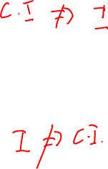
Conditional independence vs. independence
$A⊥B|C \overset{⇒}{}A⊥B ??$
$A⊥B\overset{⇒}{}A⊥B|C ??$
False
False

Slide 50

2 Tests Cancer Example
Cancer
$$P\left( C \right)= 0.01$$
For the two tests:
$P(+|C) = 0.9$
$P(+ |¬C) = 0.2$
Test 1
Test 2
$$P\left(test1 = + | test2 = +\right)=??$$

Slide 51
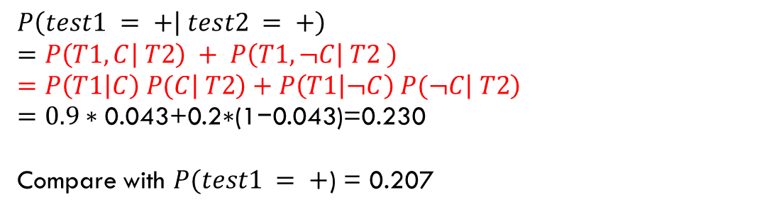
2 Tests Cancer Example
Cancer
$$P\left( C \right)= 0.01$$
For the two tests:
$P(+|C) = 0.9$
$P(+ |¬C) = 0.2$
Test 1
Test 2
$$P\left(test1 = + | test2 = +\right)$$
$$=P\left(T1,C | T2\right) + P\left(T1,¬C | T2 \right)=P\left(T1\left|C\right) P(C | T2\right)+P\left(T1\left|¬C\right) P(¬C | T2\right)=0.9∗\text{0.043}\text{+0.2∗(1−0.043)}\text{=0.230}$$
Compare with $P(test1 = +$) = 0.207
Notes:
$P(test1 = +$) = 0.9*0.01+0.2*0.99=0.207

Slide 52
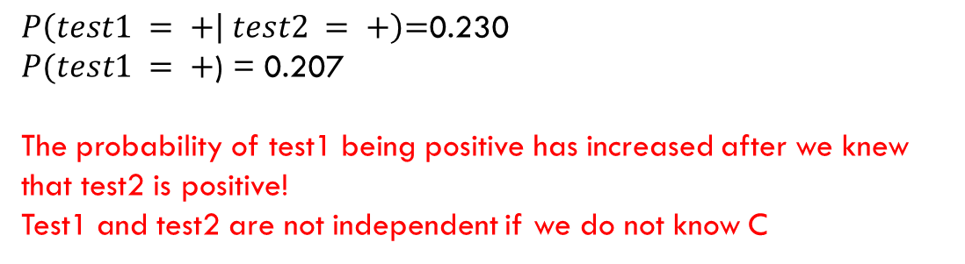
2 Tests Cancer Example
Cancer
$$P\left( C \right)= 0.01$$
For the two tests:
$P(+|C) = 0.9$
$P(+ |¬C) = 0.2$
Test 1
Test 2
$$P\left(test1 = + | test2 = +\right)\text{=}\text{0.230}$$
$P(test1 = +$) = 0.207
The probability of test1 being positive has increased after we knew that test2 is positive!
Test1 and test2 are not independent if we do not know C

Slide 53
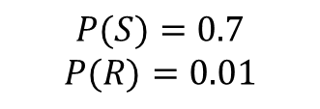
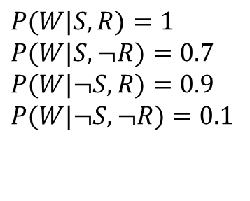
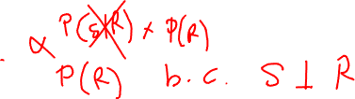

Sprinkler/Rain Example
$$P(W|S,R)=1$$
$$P(W|S,¬R)=0.7$$
$$P(W|¬S,R)=0.9$$
$$P(W|¬S,¬R)=0.1$$
Sprinkler
Rain
$$P(S)=0.7$$
$$P(R)=0.01$$
Wet Grass
$$P(R|S)=?$$

Slide 54

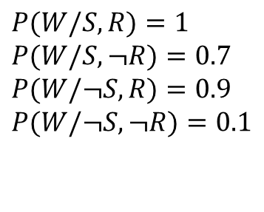


Sprinkler/Rain Example
$$P(W/S,R)=1$$
$$P(W/S,¬R)=0.7$$
$$P(W/¬S,R)=0.9$$
$$P(W/¬S,¬R)=0.1$$
Sprinkler
Rain
$$P(S)=0.7$$
$$P(R)=0.01$$
Wet Grass
$$P\left(R | S\right)=P\left(R\right)=0.01$$
$$R⊥S$$
Given no knowledge about the grass (wet or not), R and S are independent

Slide 55

Explaining away: Sprinkler/Rain Example
$$P(W/S,R)=1$$
$$P(W/S,¬R)=0.7$$
$$P(W/¬S,R)=0.9$$
$$P(W/¬S,¬R)=0.1$$
Sprinkler
Rain
$$P(S)=0.7$$
$$P(R)=0.01$$
Wet Grass
$$P(R|W,S)=?$$

Slide 56


Explaining away: Sprinkler/Rain Example
$$P(W/S,R)=1$$
$$P(W/S,¬R)=0.7$$
$$P(W/¬S,R)=0.9$$
$$P(W/¬S,¬R)=0.1$$
Sprinkler
Rain
$$P(S)=0.7$$
$$P(R)=0.01$$
Wet Grass
$$P\left(R | W,S\right)=\frac{P\left(W | R,S\right)P\left(R|S\right)}{P\left(W | S\right)}=\frac{1∗0.01}{1∗0.01+0.99∗0.7}=0.0142$$
R and S are conditionally dependent if we know W
A little more than the prior

Slide 57

Explaining away: Sprinkler/Rain Example
$$P(W/S,R)=1$$
$$P(W/S,¬R)=0.7$$
$$P(W/¬S,R)=0.9$$
$$P(W/¬S,¬R)=0.1$$
Sprinkler
Rain
$$P(S)=0.7$$
$$P(R)=0.01$$
Wet Grass
$$P(R|W)=?$$
The grass is wet.
If we don’t know about the Sprinkler, do you expect the probability of the Rain to be higher?

Slide 58

Explaining away: Sprinkler/Rain Example
$$P(W/S,R)=1$$
$$P(W/S,¬R)=0.7$$
$$P(W/¬S,R)=0.9$$
$$P(W/¬S,¬R)=0.1$$
Sprinkler
Rain
$$P(S)=0.7$$
$$P(R)=0.01$$
Wet Grass
$$P\left(R | W\right)=\frac{P\left(W | R\right)P\left(R\right)}{P\left(W\right)}=\frac{P\left(W | R,S\right)P\left(S\right)P\left(R\right)+P\left(W | R,¬S\right)P\left(¬S\right)P\left(R\right)}{P\left(W\right)}=\frac{1∗0.7∗0.01+0.9∗0.3∗0.01}{1∗0.7∗0.01+0.9∗0.3∗0.01+0.1∗0.3∗0.99+0.7∗0.7∗0.99}=\frac{0.0097}{0.5245}=0.01849$$

Slide 59


Explaining away: Sprinkler/Rain Example
$$P(W/S,R)=1$$
$$P(W/S,¬R)=0.7$$
$$P(W/¬S,R)=0.9$$
$$P(W/¬S,¬R)=0.1$$
Sprinkler
Rain
$$P(S)=0.7$$
$$P(R)=0.01$$
Wet Grass
If we don’t know about the sprinkler the probability of the rain is higher
$$P\left(R | S\right)=P\left(R\right)=0.01$$
$$P\left(R | W,S\right)=0.0142$$
$$P\left(R | W\right)=0.01849$$
$$P\left(R | W,¬S\right)=0.083$$
$$R⊥S | W$$
If the sprinkler is closed, the probability of rain gets even higher

Slide 60



D-separation or reachability
Common cause: Test1 and test2 are conditionally independent knowing C
Explaining away: S and R are conditionally dependent knowing W
In graphical representation, the conditional independence is called:
d-separation
X
Z
Y
X
Z
Y
X
Z
Y
D-separated
D-separated
D-separated

Slide 61


Joint distribution in BN
$$P\left(x_{1}, …,x_{n}\right)= \prod_{i=1}^{n}{P(x_{i}|Parents\left(x_{i}\right))}$$
Why?
Chain rule:
$$P\left(x_{1},x_{2},{…,x}_{n}\right)=\prod_{i}{P(}x_{i}|x_{1}, …,x_{i−1})$$
Assuming conditional independence of each node given its parents:
$${P(x}_{i}\left|x_{1}, …,x_{i−1}\right)=P(x_{i}|Parents\left(x_{i}\right))$$

Slide 62


Example
$P\left(A,B,C,D,E\right)=P\left(A\right) P\left(B\right) P\left(C | A,B\right) P\left(D | C\right) P\left(E | C\right)$
Without knowing the structure of the graph we need 2⁵-1 to represent all the joint probabilities
With the Bayes network, we need only 2+4+2+2= 10 parameters
This is a key advantage of Bayes networks!
A
B
C
D
E

Slide 63

Example
Burglary
Earthquake
B | P(B)
+b | 0.001
-b | 0.999
E | P(E)
+e | 0.002
-e | 0.998
Alarm
B | E | A | P(A|B,E)
+b | +e | +a | 0.95
+b | +e | -a | 0.05
+b | -e | +a | 0.94
+b | -e | -a | 0.06
-b | +e | +a | 0.29
-b | +e | -a | 0.71
-b | -e | +a | 0.001
-b | -e | -a | 0.999
John Calls
Marry Calls
A | J | P(J|A)
+a | +b | 0.9
+a | -b | 0.1
-a | +b | 0.05
-a | -b | 0.95
A | M | P(M|A)
+a | +m | 0.7
+a | -m | 0.3
-a | +m | 0.01
-a | -m | 0.99
P(+b, +e, -a, +m, -j)=?

Slide 64

Exercise: Car won’t start
How many parameters to represent the joint distribution?
How many parameters if we use the Bayes Networks representation?

Slide 65

Exercise: Car won’t start
How many parameters to represent the joint distribution? 2¹⁶-1=65535
How many parameters if we use the Bayes Networks representation? 63

Slide 66
Conclusion and perspective
Bayesian networks are a great tool for knowledge representation and inference:
Diagnostic reasoning: effect to cause inference
Predictive reasoning: cause to effect inference
Open questions:
How to learn the structure of a Bayes network ?
How to estimate its parameters ?
How to use if for inference ? (Exact inference, approximate inference, message passing algorithm)

Slide 67


Monte hall problem!

Slide 68

Exercise 1
X0 | X1 | X2 | P(X0,X1,X2)
0 | 0 | 0 | 0.080
1 | 0 | 0 | 0.140
0 | 1 | 0 | 0.100
1 | 1 | 0 | 0.180
0 | 0 | 1 | 0.120
1 | 0 | 1 | 0.080
0 | 1 | 1 | 0.160
1 | 1 | 1 | 0.140
Expression | Value
P(X0=1,X1=0,X2=1)
P(X0=0,X1=1)
P(X2=0)
P(X1=0|X0=1)
P(X0=1,X1=0|X2=1)
P(X0=1|X1=0,X2=1)

Slide 69
Exercise 1
X0 | X1 | X2 | P(X0,X1,X2)
0 | 0 | 0 | 0.080
1 | 0 | 0 | 0.140
0 | 1 | 0 | 0.100
1 | 1 | 0 | 0.180
0 | 0 | 1 | 0.120
1 | 0 | 1 | 0.080
0 | 1 | 1 | 0.160
1 | 1 | 1 | 0.140
Expression | Value
P(X0=1,X1=0,X2=1) | 0.080
P(X0=0,X1=1) | 0.260
P(X2=0) | 0.180+0.100+0.140+0.080
P(X1=0|X0=1) | (0.140+0.080)/(0.140+0.180+0.080+0.140)
P(X0=1,X1=0|X2=1) | 0.080/(0.120+0.080+0.160+0.140)
P(X0=1|X1=0,X2=1) | 0.080/(0.120+0.080)

Slide 70

Exercise 2: Z is independent from X given Y, fill the values
X | P(X)
0 | 0.600
1 | 0.400
Y | X | P(Y|X)
0 | 0 | 0.500
1 | 0 | 0.500
0 | 1 | 0.900
1 | 1 | 0.100
X | Y | Z | P(X,Y,Z)
0 | 0 | 0
1 | 0 | 0 | 0.324
0 | 1 | 0 | 0.12
1 | 1 | 0
0 | 0 | 1 | 0.03
1 | 0 | 1
0 | 1 | 1 | 0.18
1 | 1 | 1
Z | Y | P(Z|Y)
0 | 0 | 0.900
1 | 0 | 0.100
0 | 1 | 0.400
1 | 1 | 0.600
X | Y | P(X,Y)
0 | 0
1 | 0
0 | 1
1 | 1

Slide 71
Exercise 2: Z is independent from X given Y –solution
X | P(X)
0 | 0.600
1 | 0.400
Y | X | P(Y|X)
0 | 0 | 0.500
1 | 0 | 0.500
0 | 1 | 0.900
1 | 1 | 0.100
X | Y | Z | P(X,Y,Z)
0 | 0 | 0 | 0.6*0.5*0.9
1 | 0 | 0 | 0.324
0 | 1 | 0 | 0.12
1 | 1 | 0 | 0.4*0.1*0.4
0 | 0 | 1 | 0.03
1 | 0 | 1 | 0.4*0.9*0.1
0 | 1 | 1 | 0.18
1 | 1 | 1 | 0.4*0.1*0.6
Z | Y | P(Z|Y)
0 | 0 | 0.900
1 | 0 | 0.100
0 | 1 | 0.400
1 | 1 | 0.600
X | Y | P(X,Y)
0 | 0 | 0.6*0.5
1 | 0 | 0.4*0.9
0 | 1 | 0.6*0.5
1 | 1 | 0.4*0.1

Slide 72

X is independent from Y?
X | Y | P(X,Y)
0 | 0 | 0.120
1 | 0 | 0.080
0 | 1 | 0.480
1 | 1 | 0.320
X | P(X)
0 | 0.600
1 | 0.400
X | Y | P(X|Y)
0 | 0 | 0.600
1 | 0 | 0.400
0 | 1 | 0.600
1 | 1 | 0.400
Notes:
YES

Slide 73

X is independent from Y ?
X | Y | P(X,Y)
0 | 0 | 0.200
1 | 0 | 0.120
0 | 1 | 0.320
1 | 1 | 0.360
X | P(X)
0 | 0.520
1 | 0.480
Y | P(Y)
0 | 0.320
1 | 0.680
Notes:
NO

Slide 74

X is independent from Y given Z?
X | Y | Z | P(X,Y,Z)
0 | 0 | 0 | 0.320
1 | 0 | 0 | 0.160
0 | 1 | 0 | 0.080
1 | 1 | 0 | 0.240
0 | 0 | 1 | 0.040
1 | 0 | 1 | 0.040
0 | 1 | 1 | 0.100
1 | 1 | 1 | 0.020
X | Y | Z | P(X,Y|Z)
0 | 0 | 0 | 0.400
1 | 0 | 0 | 0.200
0 | 1 | 0 | 0.100
1 | 1 | 0 | 0.300
0 | 0 | 1 | 0.200
1 | 0 | 1 | 0.200
0 | 1 | 1 | 0.500
1 | 1 | 1 | 0.100
X | Z | P(X|Z)
0 | 0 | 0.500
1 | 0 | 0.500
0 | 1 | 0.700
1 | 1 | 0.300
Y | Z | P(Y|Z)
0 | 0 | 0.600
1 | 0 | 0.400
0 | 1 | 0.400
1 | 1 | 0.600
Notes:
No

Slide 75

X is independent from Y given Z?
X | Y | Z | P(X,Y,Z)
0 | 0 | 0 | 0.144
1 | 0 | 0 | 0.016
0 | 1 | 0 | 0.216
1 | 1 | 0 | 0.024
0 | 0 | 1 | 0.048
1 | 0 | 1 | 0.072
0 | 1 | 1 | 0.192
1 | 1 | 1 | 0.288
X | Y | Z | P(X|Y,Z)
0 | 0 | 0 | 0.900
1 | 0 | 0 | 0.100
0 | 1 | 0 | 0.900
1 | 1 | 0 | 0.100
0 | 0 | 1 | 0.400
1 | 0 | 1 | 0.600
0 | 1 | 1 | 0.400
1 | 1 | 1 | 0.600
X | Z | P(X|Z)
0 | 0 | 0.900
1 | 0 | 0.100
0 | 1 | 0.400
1 | 1 | 0.600
Notes:
Yes

